Slide 1
LED board rework SOP
2020/08/24

Slide 2
I2C conflicts with AD82584F and LP5036
AD82584F I2C address: 0x31
LP5036 I2C address: 0x30~0x33
Current design is 0x30 and 0x31, so 0x31 of LP5036 needs to change as 0x33 due to easy for rework.
LP5036 is located in 96.1515T00* LED board of 96.1529T00*.
U3_1 and U3_2 are LP5036 and needs to change U3_2 I2C address.
  U3_2: 0x31→0x33, ADDR1=GND→ ADDR1=Vcc3.3.
Currently LED I2C address | LED Driver
0x2A | U3_3(LP5024)
0x30 | U3_1(LP5036)
0x31(conflict) | - U3_2(LP5036) - AD82584F
0x32
0x33
Note *: 96.1515T00: LED board, 96.1529T00: panel of Sub board

Slide 3
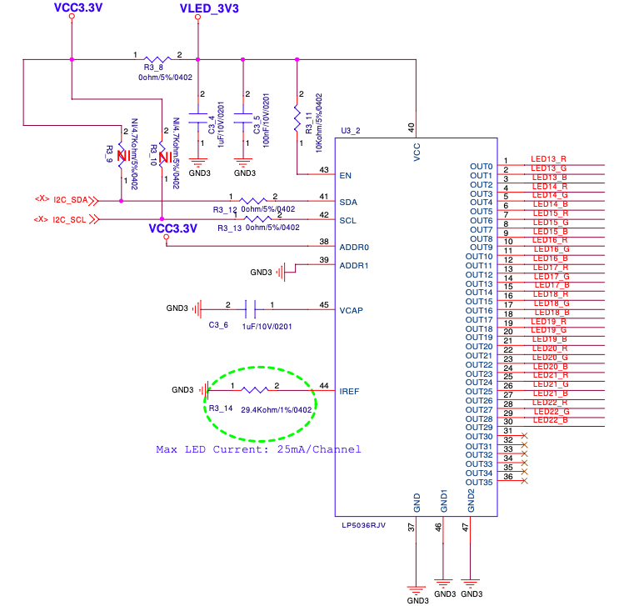
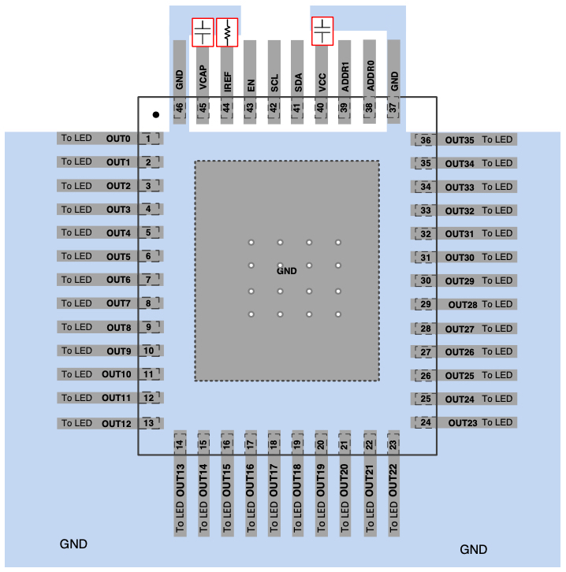
U3_2(LP5036) rework pin
Schematic of LED board: 96.1515T00

Slide 4
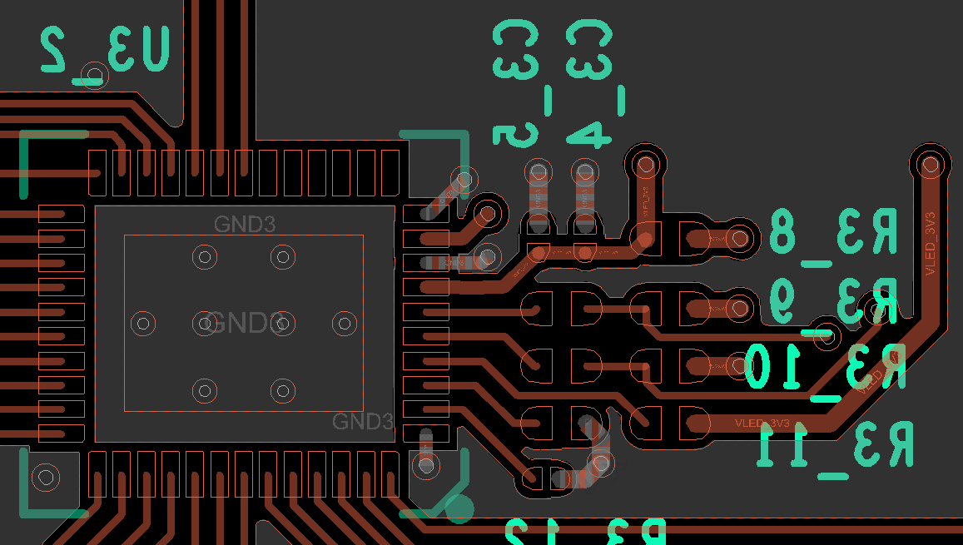
Layout of U3_2
Cut off line
Rework steps:
Cut off GND at Pin 39.
Shorten Pin38 and Pin39 by solder.
Pin38: ADDR0
Pin39: ADDR1
Shorten these 2 pin:
Pin38 and Pin39
U3_2: LP5036

Slide 5
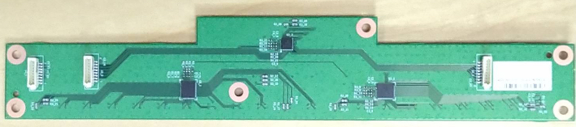
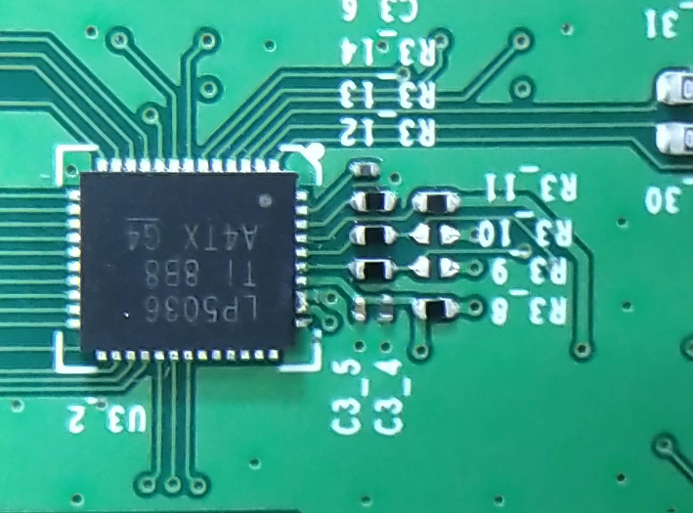
Finished rework
U3_2: LP5036
Pin39
Pin38
1. Cut off net
2. Soldering together

Slide 6
Rework U3_2(LP5036) for I2C address
After rework, the LED driver function is ok for 0x31→0x33 of U3_2(LP5036) verified by SW team.
Need 2 steps to rework
  Cut off net of Pin39
  Solder Pin38 and Pin39 together.
QFN package is small and a little bit difficult to rework.

Slide 7
Audio AMP rework SOP
2020/08/31

Slide 8
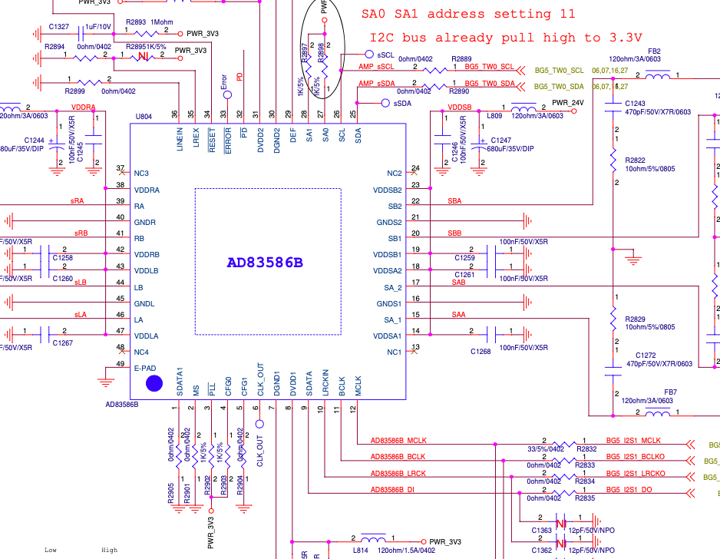
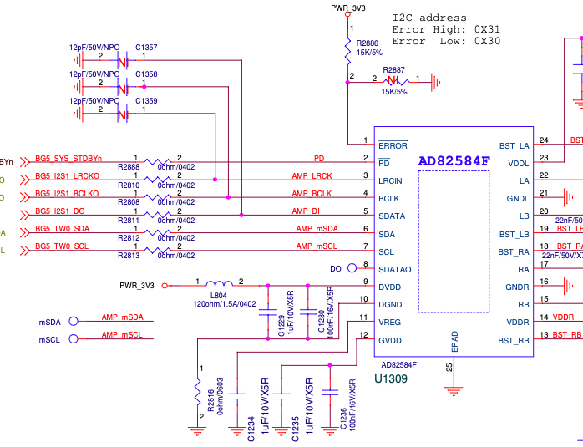
AD83586B & AD83584F-Schematic

Slide 9
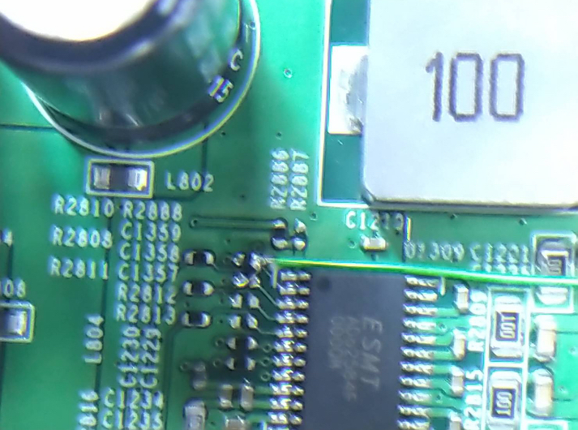
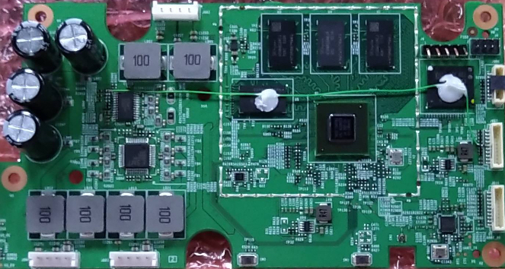
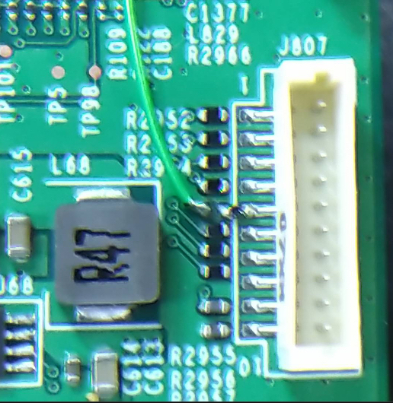
PD pin rework.
PD: Remove R2888 original 0 ohm resistor. Change 10K ohm to GND.
GPIO 32: Use Volume up key to be used for PD pin.

Slide 10
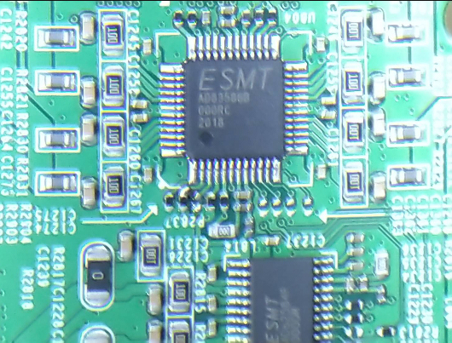
PLL pin rework.
PLL: Change 1K to GND.

Slide 11
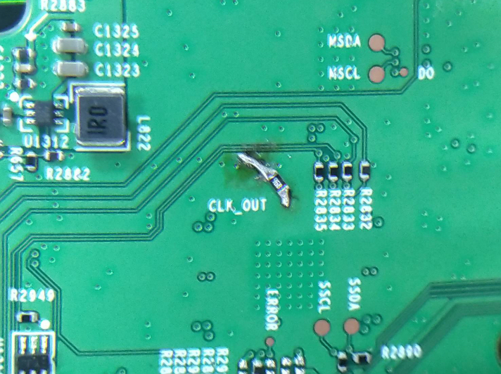
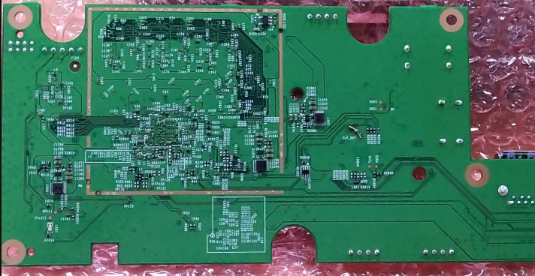
CLK_OUT pin rework.
CLK_OUT: Change 10K to PWR_3V3.

Slide 12
Rework point of AD83586B/AD83584F audio AMP
1. PIN 3: /PLL
  --> Need to connect a 1K pulled-low RES to GND. This is for using internal PLL instead of external clock source for MCLK. Since the current system MCLK is 24MHz, which can not meet the MCLK frequency requirement of AD83586B.
2. PIN 6: CLK_OUT
  --> Need to connect a 10K pulled-high RES to PWR_3V3, This is to set PLL ratio to one time instead of 4 times to avoid the system MCLK over flow and cause noise issue.
3. PIN 32: /PD
  --> Need to connect it to a normal GPIO instead of always-on SM_GPIO9 (we will rework /PD pin connect to GPIO32, which is used for volume up control in EVT board) , and connected a 10K pulled-low resistor to GND.
  This is used to set the /PD pin remain in low state and ensure that the audio AMP enter to power down mode during the system reboot due to unexpected event.

